Slide 1
Async with Redux

Slide 2
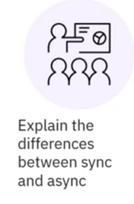
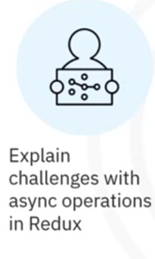



What you will learn

Slide 3
Operation behavior
Synchronous
Operation 1
Operation 2
Operation 3
Asynchronous
Operation 1
Operation 2
Operation 3

Slide 4
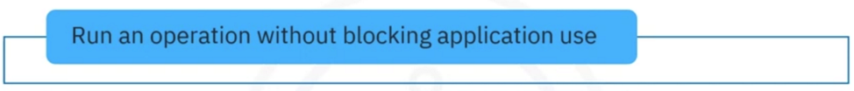
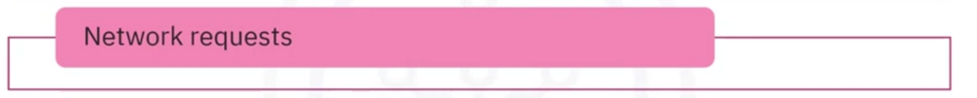

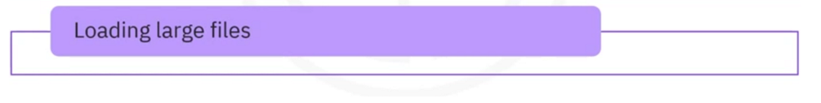
When to use async

Slide 5



Problems with async example
Synchronous behavior

Slide 6



Problems with async example

Slide 7




Synchronous behavior

Slide 8



Problems with async example
Asynchronous behavior

Slide 9
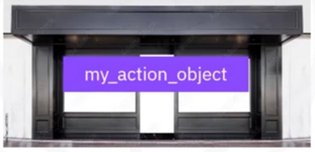
Redux behavior
Redux requires sync
my_action_creator()
return{
}

Slide 10



Redux behavior
Redux requires sync
my_action_creator()
return{
}

Slide 11

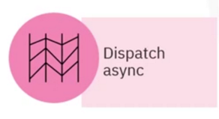
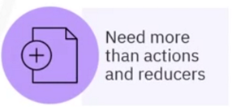

Async dispatching

Slide 12





Middleware
Thunk
Saga

Slide 13




Thunk

Slide 14

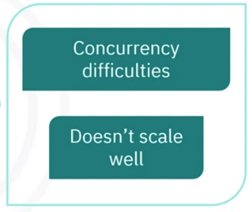


Thunk pros and cons

Slide 15
Saga
Generator functions
Called Sagas
Encapsulate async Logic
Multitask with dispatch process
Pause and resume as needed

Slide 16
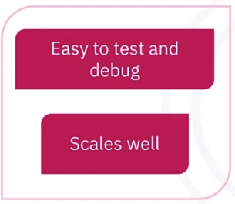
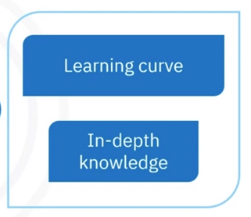


Saga pros and cons

Slide 17
Recap
In this video, you Learned that:
• Synchronous operations bLock
• Asynchronous operations run in parallel
• JavaScript behaves async, but Redux requires sync
• Thunk action creators return functions that allow you to perform sync and
async operations
• Thunk middleware ¡s suitable for simple applications and relatively easy to learn
• Thunk does not scale well and requires planning to handle concurrency
issues
• Saga uses generator functions which allow you to multitask
• Saga makes testing and debugging easy
• Saga is more complicated to Learn

